Slide 1
Audio Intelligence
Presented By:
Manish Maheswaran

Slide 2
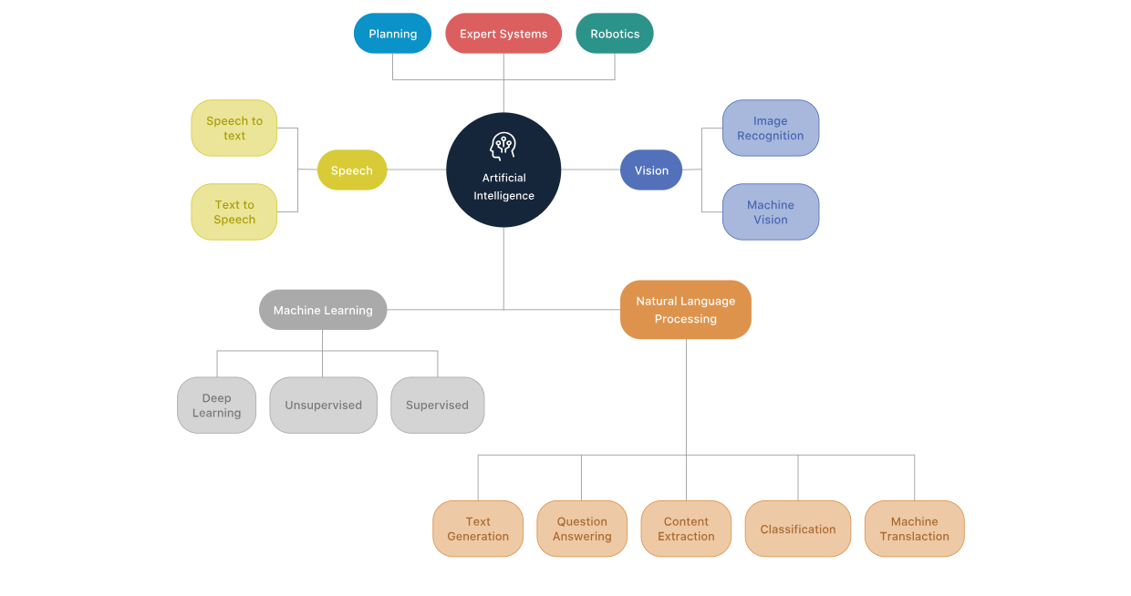

Slide 3
What is Speech Recognition?

Slide 4
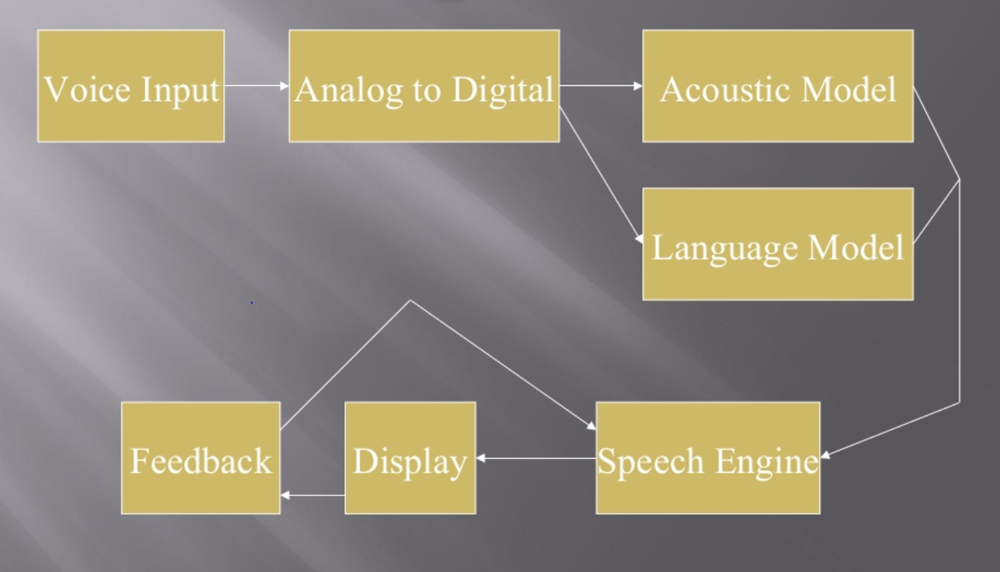
Work flow

Slide 5
Terms and Concepts
Low Signal to Noise Ratio
Overlapping Speech
Homonyms
Eg:- their, air, heir & be, bee
Grammars
Accuracy

Slide 6
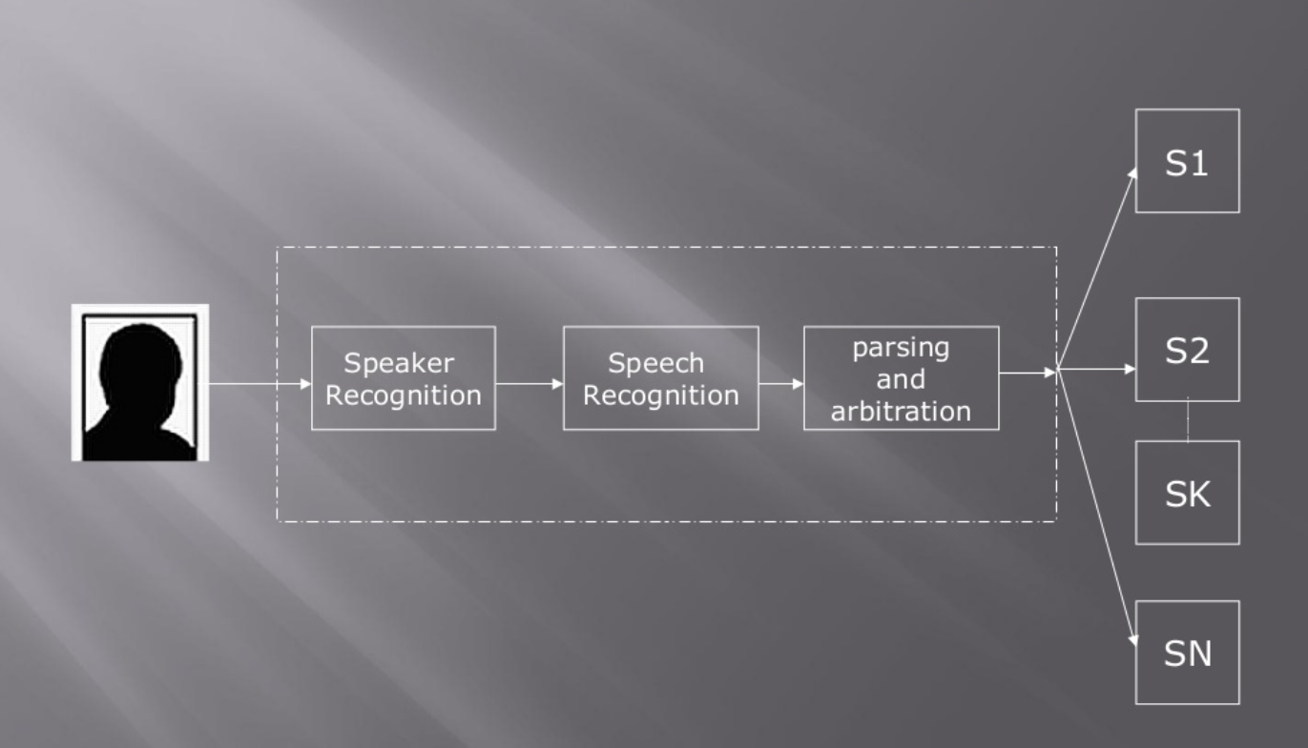
Process of speech recognition

Slide 7
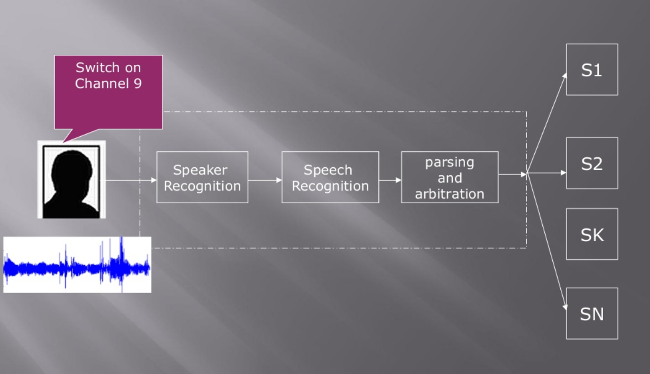

Slide 8
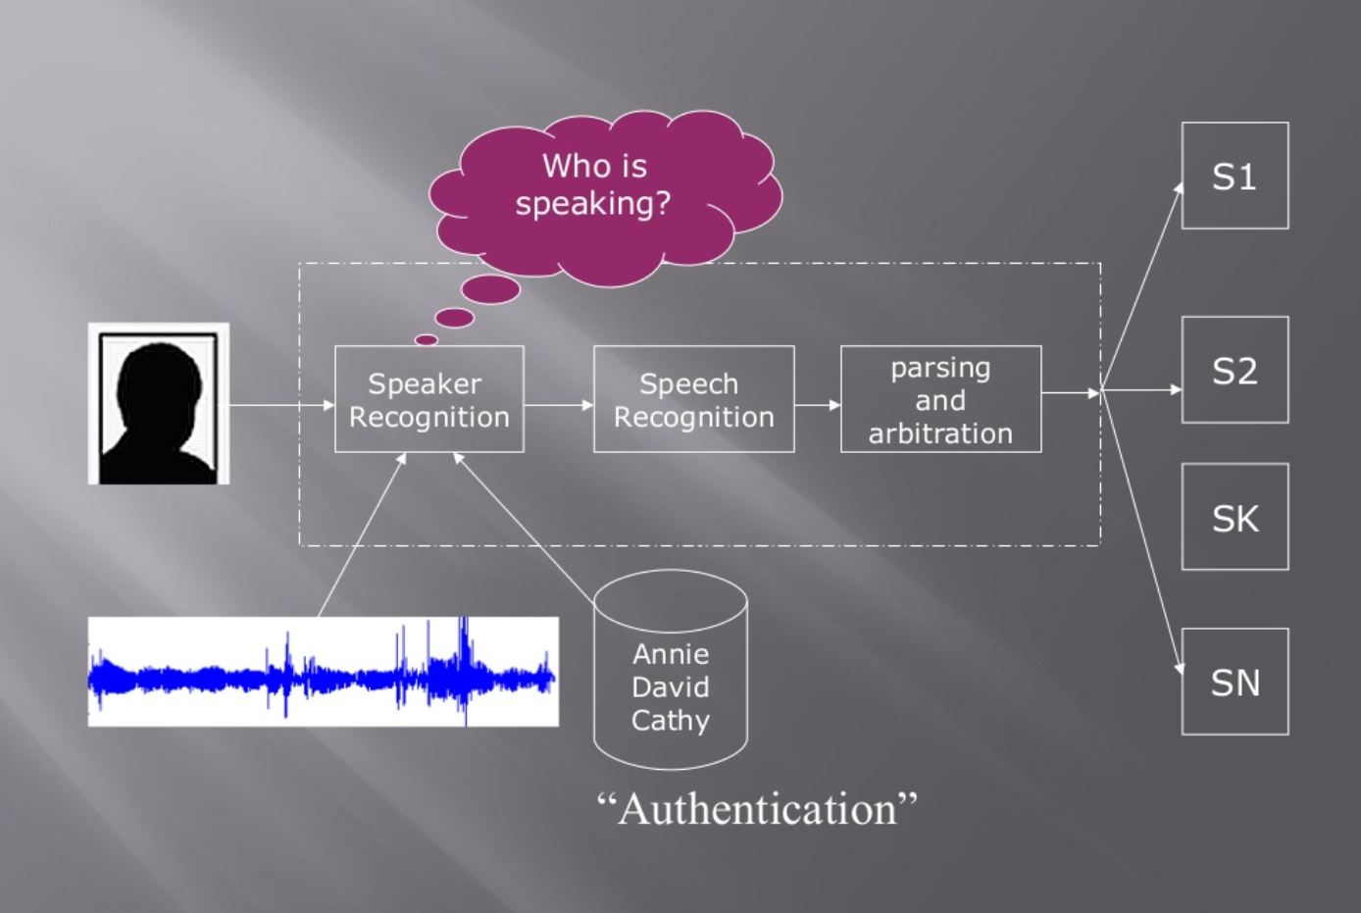

Slide 9
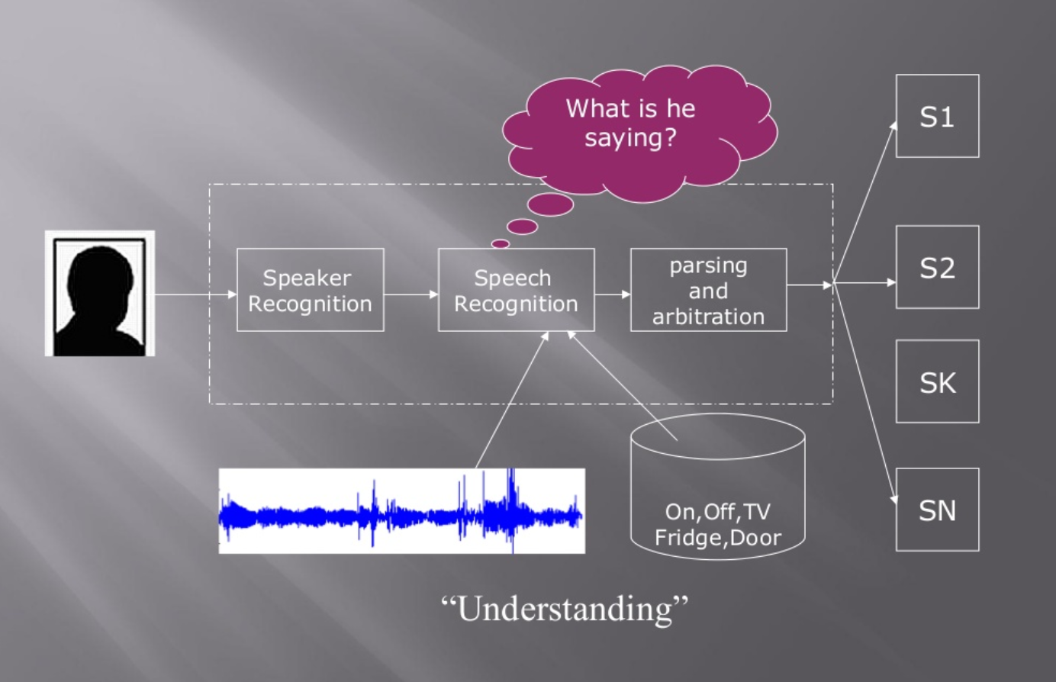

Slide 10
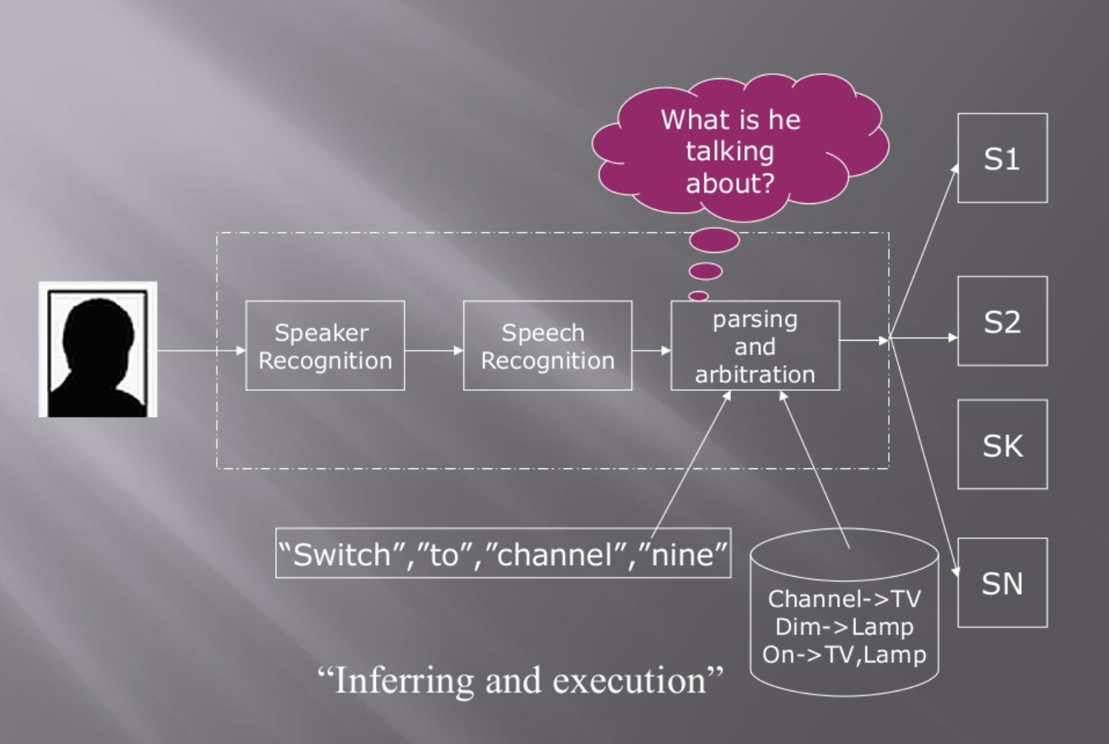

Slide 11
Where can it be used?
System Control/navigation
GPS – Connected digital maps – “Navigate to the nearest Chinese restaurant”.
Commercial/Industrial Applications
Google Home, Alexa, Siri, Cortana, Bixby.
Voice Dialling
“Dial home.”
Similarity search for audio files (aka Shazam)
Translator

Slide 12
Software's Used
Discrete Speech Software
Python

Slide 13
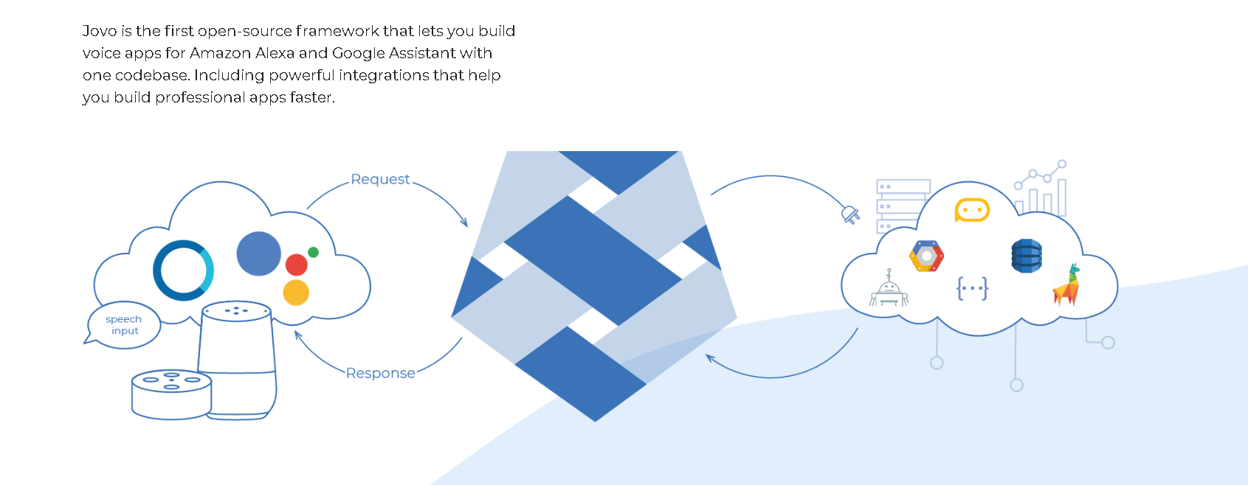
Frameworks
Jovo – Google Home, Alexa

Slide 14
references
https://www.scribd.com/doc/30102999/Artificial-Intelligence-for-Speech-Recognition
https://www.slideshare.net/jhonrehmat/speech-recognition-system
https://www.leewayhertz.com/what-is-artificial-intelligence-understand-ai-in-5-minutes/
https://electronics.howstuffworks.com/gadgets/high-tech-gadgets/speech-recognition.htm
https://electronics.howstuffworks.com/gadgets/high-tech-gadgets/mit-headset-hears-thoughts.htm
https://electronics.howstuffworks.com/gadgets/high-tech-gadgets/mit-headset-hears-thoughts.htm

Slide 15

Any queries?

Slide 16

Thank You

